Slide 1

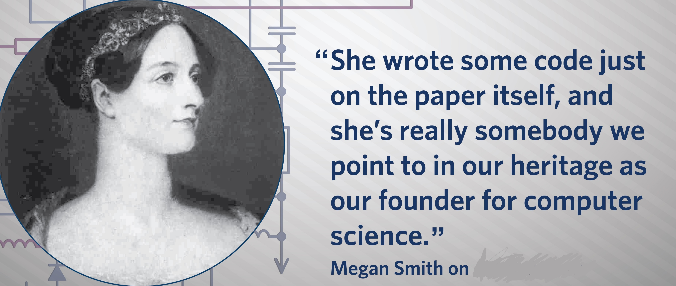

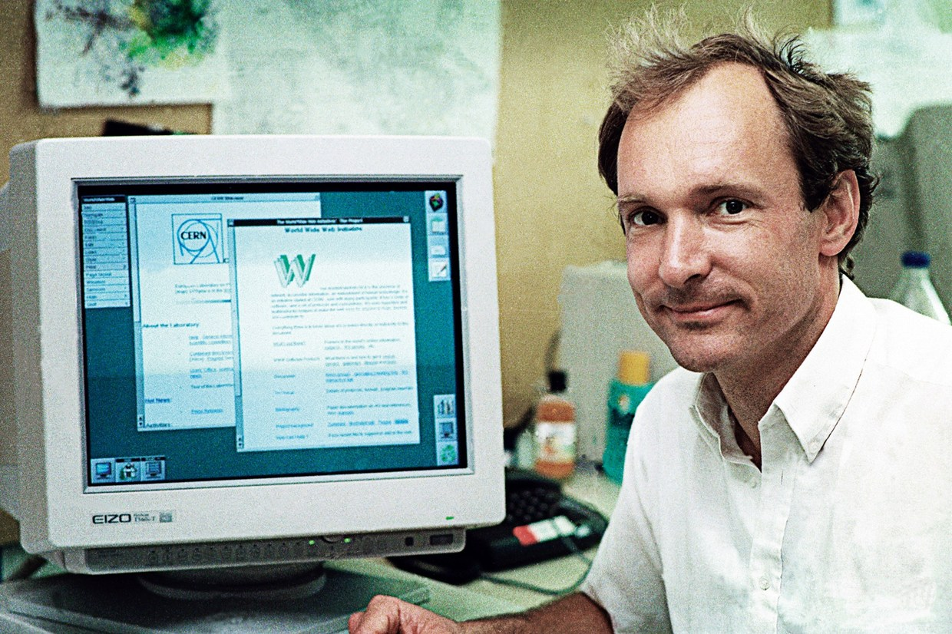
Design better

Slide 2
Ada Lovelace
Mark Zuckerberg
Design better
Jonathan Ive
Tim Berners-Lee

Slide 3
HTML
T-level

Slide 4
How are web pages made?
HTML stands for Hyper Text Markup Language
It describes structure

Slide 5
Last time - Building your first web page
Open notepad
Type in the following:
<p>
hello world!
</p>
index.html
Save it as

Slide 6
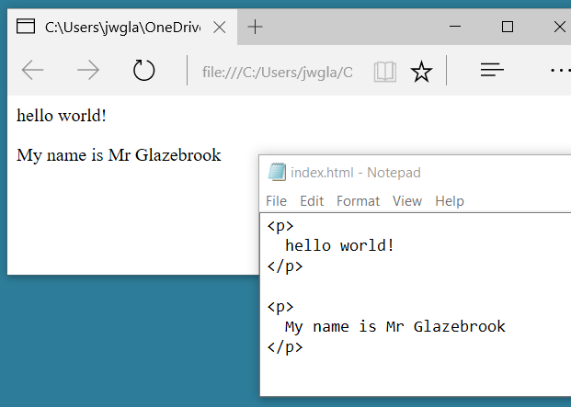

Slide 7

Things to note
<p>
hello world!
</p>
HTML tags come in pairs
An open tag
A close tag
Some tags are self closing <br />
The HTML element is everything from the start tag to the end tag:

Slide 8
Experiment with the following tags
<p> hello world! </p>
<h1> this is a title </h1>
<p> this is <b>bold</b> text </p>
<p> this is <i>italic</i>. </p>
You and your hobbies!
Show me how far you got!

Slide 9
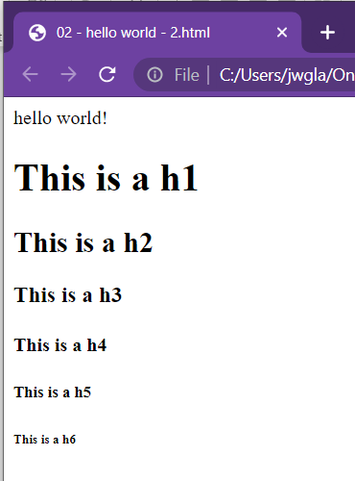
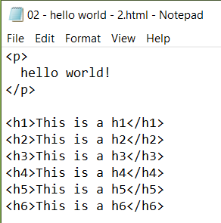
Heading tags

Slide 10
images
Save to the same folder as your web page
Use the following tag to show your image
<img src=“kite.jpg”>
<img src=“kite.jpg” width=“100” height=“50”>

Slide 11
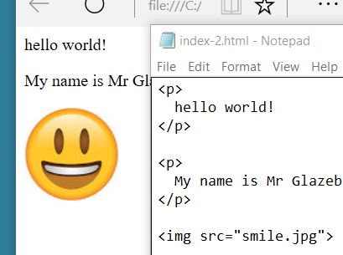

Slide 12
What do the following tags do?
<p>
<i>
<b>
<img>
What does HTML
stand for?

